Slide 1
Problem Solving

Slide 2
Problem: Make It Beautiful
(Problem Source: https://codeforces.com/problemset/problem/2118/C )
You are given an array a of n integers.
We define the beauty of a number x to be the number of 1 bits in its binary representation.
We define the beauty of an array to be the sum of beauties of the numbers it contains.
In one operation, you can select an index I (1≤i≤n) and increase a_{i} by 1.
Find the maximum beauty of the array after doing at most k operations.

Slide 3
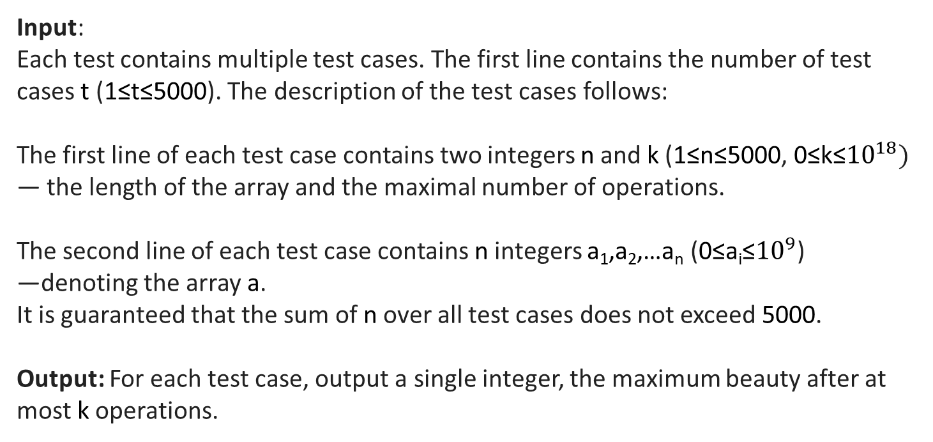
Input: Each test contains multiple test cases. The first line contains the number of test cases t (1≤t≤5000). The description of the test cases follows:
The first line of each test case contains two integers n and k (1≤n≤5000, 0≤k≤${10}^{18})$
— the length of the array and the maximal number of operations.
The second line of each test case contains n integers a₁,a₂,…a_{n} (0≤a_{i}≤${10}^{9}$)
—denoting the array a.
It is guaranteed that the sum of n over all test cases does not exceed 5000.
Output: For each test case, output a single integer, the maximum beauty after at most k operations.
Example
Input
2
5 2
0 1 7 2 4
5 3
0 1 7 2 4
Output
8
9

Slide 4
The Solution

Slide 5
Algorithm: Maximum Beauty of an Array
Input:
t — number of test cases
For each test case:
n — size of array
k — maximum number of operations
a[1..n] — array of integers
Output:
Maximum beauty of the array after at most k increment operations

Slide 6
Algorithm: Maximum Beauty of an Array
Steps:
Read Input
Read the number of test cases t.
For each test case, read n, k, and the array a.
Compute Initial Beauty
Initialize beauty = 0.
For each element x in a, add the number of 1 bits in its binary representation to beauty.
(__builtin_popcountll(x) in C++ or equivalent)
Perform Increment Operations Greedily
While k > 0:
Initialize index = -1.
For each element a[i] in the array:
Compute before = number of 1s in a[i]
Compute after = number of 1s in a[i] + 1
If after > before, set index = i and break the loop.
If index == -1, no further gain is possible → break.
Otherwise:
Increment a[index] by 1.
Increment beauty by 1.
Decrement k by 1.
Output Result
Print the final value of beauty for the current test case.
Repeat for all test cases

Slide 7
while (k > 0)
{
long long index = -1;
for (long long i = 0; i < n; i++)
{
long long before = __builtin_popcountll(a[i]);
long long after = __builtin_popcountll(a[i] + 1);
if (after > before)
{
index = i;
break;
}
}
if (index == -1) break;
a[index]++;
beauty++;
k--;
}
cout << beauty << "\n";
}
}
#include <iostream>
#include <vector>
using namespace std;
int main() {
int t;
cin >> t;
while (t--)
{
long long n, k;
cin >> n >> k;
vector<long long> a(n);
long long beauty = 0;
for (long long i = 0; i < n; i++)
{
cin >> a[i];
beauty += __builtin_popcountll(a[i]);
}

Slide 8
Time Complexity
Case | Complexity Description | Big-O
Best Case | Few increments, each O(n) scan | O(n)
Worst Case | Huge k → many increments, each O(n) scan | O(n × k)
Average Case | Moderate k, bounded by bits | O(n × k)

